Slide 1


Library Database Analysis

Slide 2


About Me
Name: Ramani Sruthi
Batch No: 435
Linkedin: https://www.linkedin.com/in/ramani-sruthi-70884a29b/
GitHub: http://github.com/sruthi-ramani

Slide 3

Agenda
Objective of the Project
ER Diagram and schema explanation
Key analysis questions (use cases)
SQL query results with screenshots or summaries
Final business insights and recommendations
Conclusion (key finding overall)
Q&A Slide

Slide 4
Business Problem Statement
– Library Data Set
Libraries using manual or unorganized records facing difficulties in tracking books, members, borrow/return status, and overdue fines. This leads to inaccurate data, poor book availability management, and slow reporting.
To solve this, I have designed a SQL-based Library Management System that is very useful to centralize data, efficiently manage library operations, and support quick, accurate decision-making.

Slide 5
Objective of the Project
The main goal of this project is to use SQL to analyze a library’s database so we can understand things better and make good decisions.
Goal 1: Understand how the database is set up (the maps and tables).
Goal 2: Answer important questions about books, loans, and users (like “How many copies are left?”)
Goal 3: Find out key facts and give advice to the library managers.

Slide 6
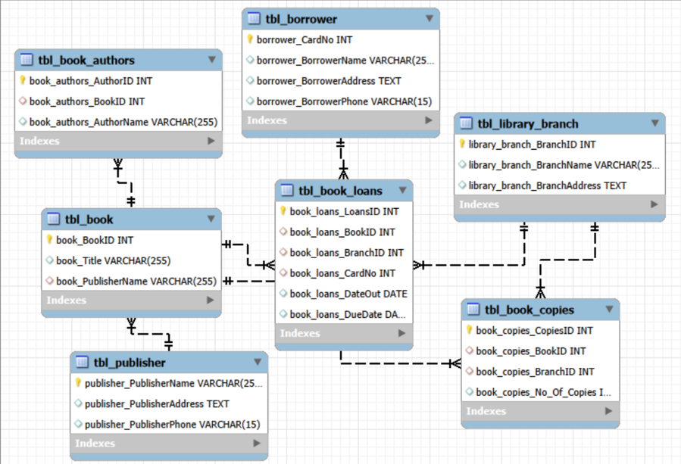
ER diagram and schema Explanation
ER diagram and schema Explanation

Slide 7
Copies at a Branch: How many copies of “The Lost Tribe” are at the “Sharpstown” branch?
Copies Everywhere: How many copies of “The Lost Tribe” does each branch have?
Inactive Users: Which library members have no books checked out right now?
Overdue Check: For a specific date (2/3/18) and branch (“Sharpstown”), who has which books, and what is their address?
Branch Activity: How many total books has each branch loaned out?
Heavy Users: Which members have more than five books checked out?
Author Inventory: For “Stephen King” books, what titles and how many copies does the “Central” branch own?
Key analysis questions (use cases)

Slide 8
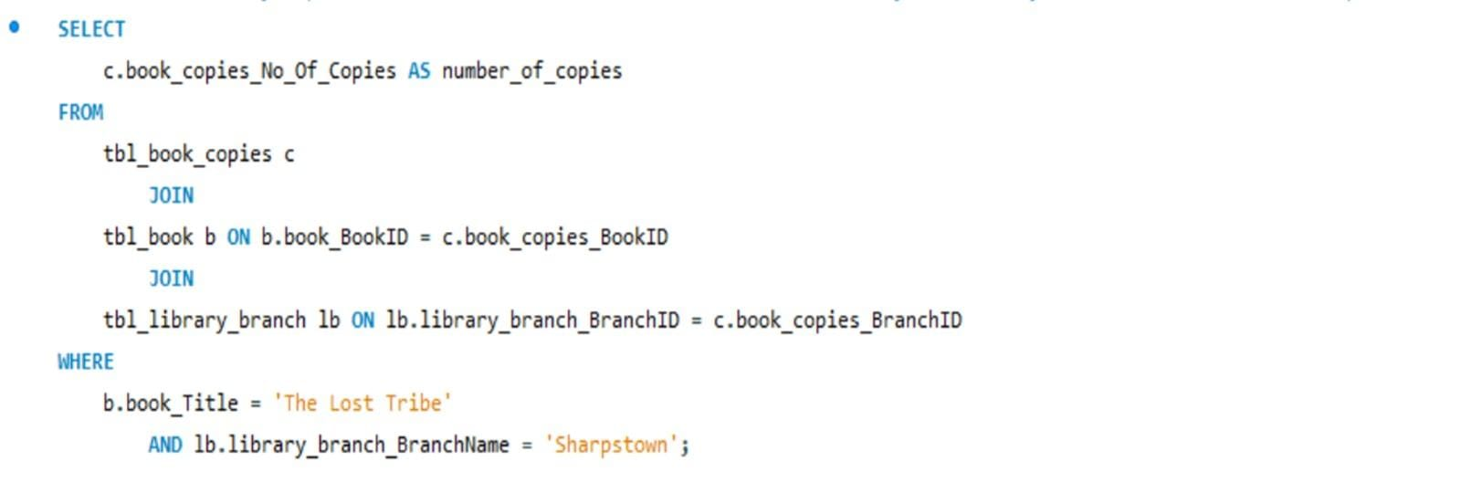
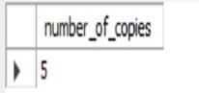
SQL querys results with Screenshots and Summaries
1. How many copies of the book titled "The Lost Tribe" are owned by the library branch whose name is "Sharpstown"?

Slide 9
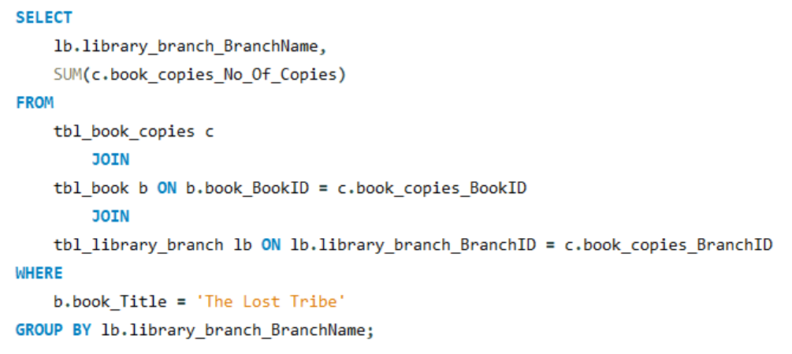
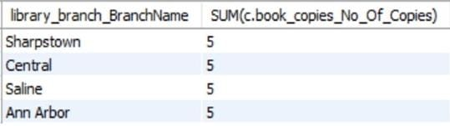
2. How many copies of the book titled "The Lost Tribe" are owned by each library branch?

Slide 10
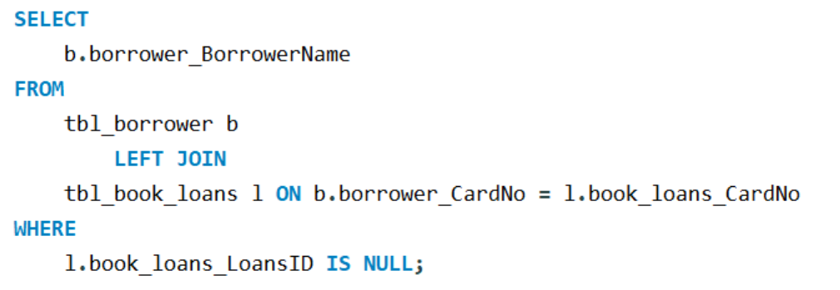
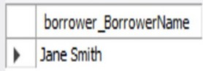
3. Retrieve the names of all borrowers who do not have any books checked out.

Slide 11
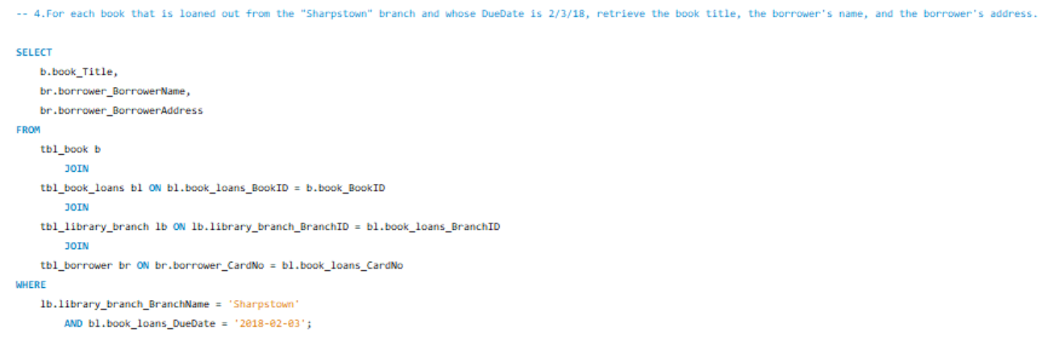
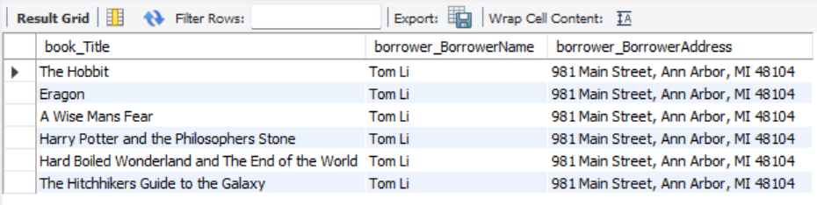
4. For each book that is loaned out from the "Sharpstown" branch and whose Due Date is 2/3/18, retrieve the book title, the borrower's name, and the borrower's address.

Slide 12
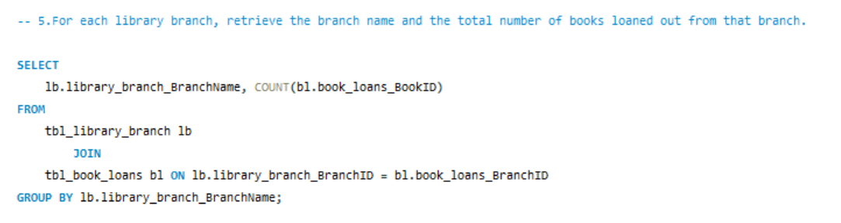
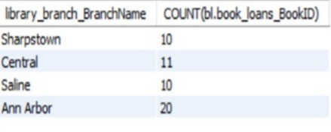

5. For each librarybranch, retrieve the branch name and the total number of books loaned out from that branch.

Slide 13
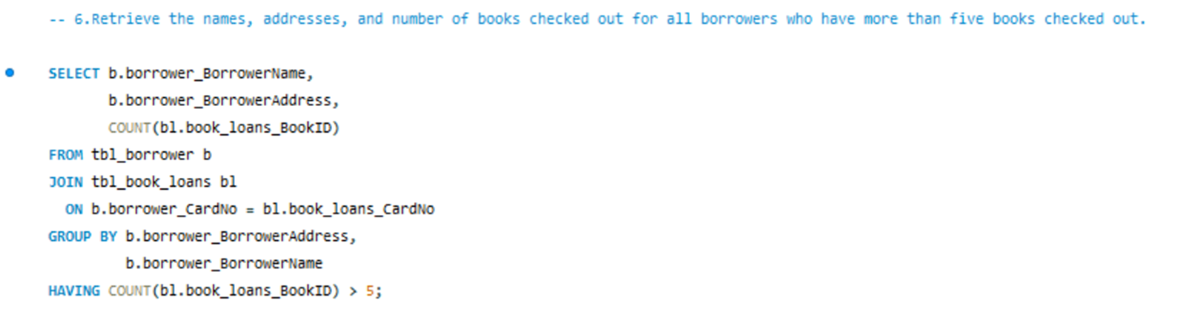
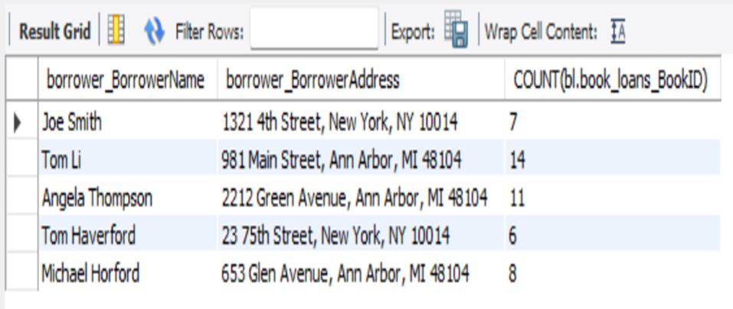
6. Retrieve the names, addresses, and number of books checked out for all borrowers who have more than five books checked out.

Slide 14
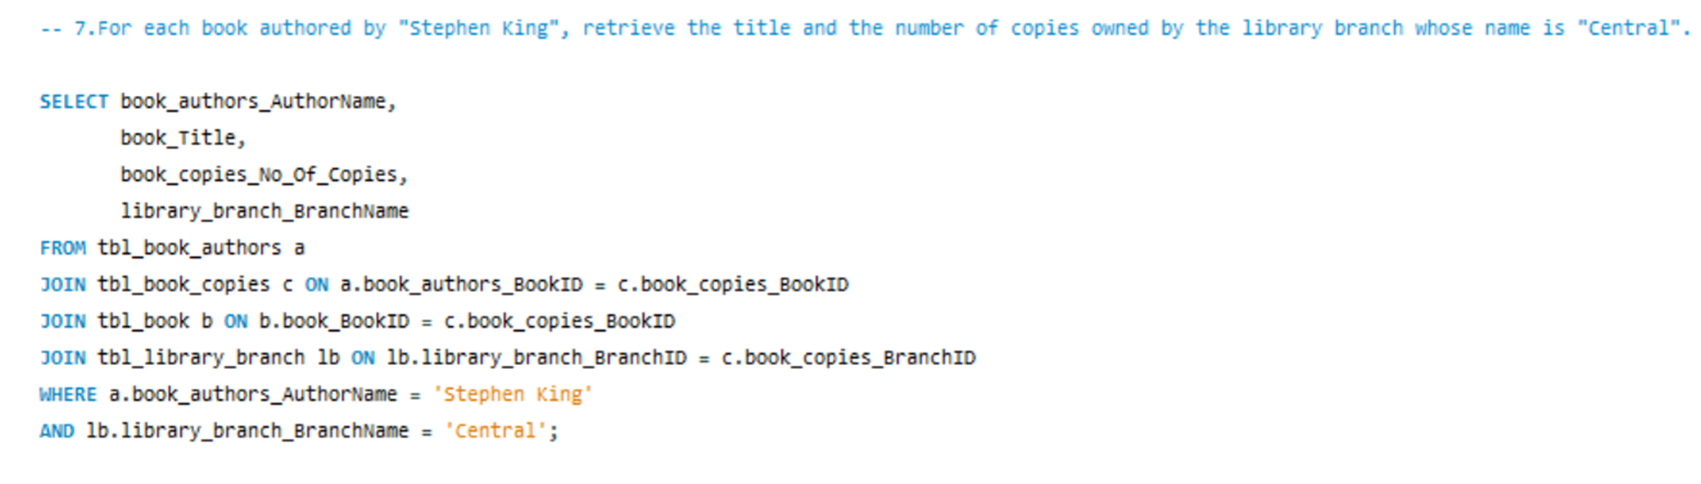
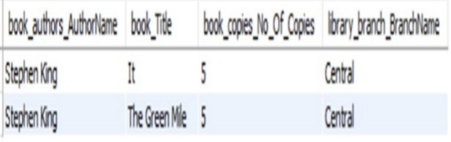

7. For each book authored by "Stephen King", retrieve the title and the number of copies owned by the library branch whose name is "Central".

Slide 15
Final business insights and recommendations
Key Insights
Book Stock is Even: The book "The Lost Tribe" has 5 copies at every branch, showing the copies were spread out equally.
Busiest Branch: The Central branch loaned out the most books overall (11 books), but it’s very close to the others (10 books each).
Heavy Borrowers: Tom Li is the most active member with 13 books checked out, followed by Joe Smith (7) and Tom Haverford (6).
Inactive User: Jane Smith has no books checked out.
Recommendations
Reward Heavy Users: Consider giving special perks or a "VIP status" to heavy borrowers like Tom Li to keep them happy and reading.
Engage Inactive Users: Try to contact Jane Smith and other inactive users with personalized emails or book suggestions to get them back to the library.
Stock Review: The Central branch is slightly busier, so maybe send a few extra copies of new, popular books there first.

Slide 16

Conclusion (Key finding overall)
The main discovery from this analysis is that the library has a few very active members and that the book distribution is mostly balanced across all branches.
SQL was a great tool to find these facts quickly and clearly.
The library should focus on encouraging inactive members while keeping their heavy users satisfied.

Slide 17


Slide 18


